Slide 1
Therapeutic Drug
Monitoring Principles
Jason C. Gallagher, Pharm.D., FCCP, BCPS

Slide 2

Objectives
At the end of the lecture, the student should be able to:
Differentiate between situations where therapeutic drug monitoring (TDM) is useful and those where it is not
Correctly determine when peak and trough concentrations for a given drug should be drawn
Define scenarios that may lead to higher or lower than expected drug concentrations

Slide 3
Objectives
At the end of the lecture, the student should be able to:
Determine if a drug concentration was drawn correctly and assess its utility
Describe the expected impact of incorrectly drawn drug concentrations

Slide 4
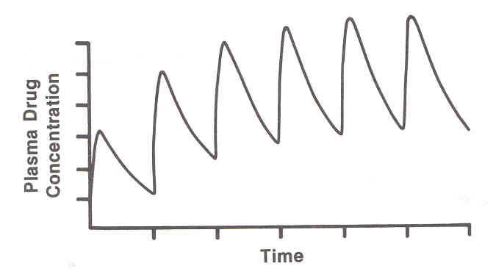
Some Terms
Therapeutic drug monitoring (TDM)
Peak
Trough
Steady-state
Therapeutic range
Toxic range

Slide 5
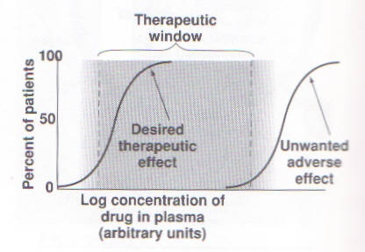
Therapeutic Range

Slide 6
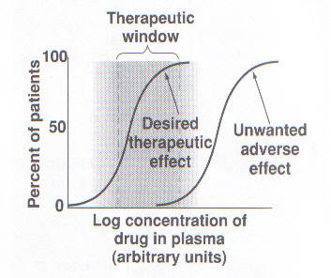
Therapeutic Range

Slide 7
Considerations with TDM
Patient characteristics
PK properties of drug monitored
Method of drug administration
Timing of drug sample
Specimen collected
Assay sensitivity

Slide 8
Clinical PK and TDM
If TDM performed, can use those values to determine patient-specific PK parameters
TDM can also be used to detect non-compliance
TDM also useful in overdose situations

Slide 9

Adjusting Drug Concentrations
Peaks are dependent on dose
  Peak concentrations are very important for some drugs
    Aminoglycosides
Troughs are dependent on the dosing interval
  Trough concentrations are monitored for most TDM drugs
    Ease
    Consistency
    Unimportant peak

Slide 10
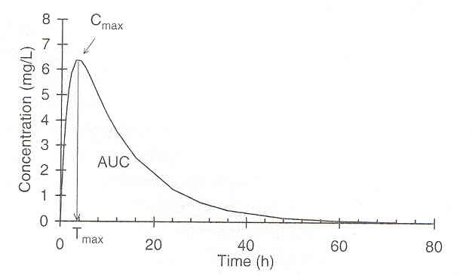
Adjusting Drug Concentrations

Slide 11
Evaluation of Drug Concentrations
Lower than expected?
Noncompliance
Dosage error
Wrong drug product
Poor bioavailability
Rapid elimination
Enlarged volume of distribution
Not at steady-state
Poor sample timing

Slide 12
Evaluation of Drug Concentrations
Higher than expected?
Noncompliance
Dosage error
Dispensing error
Wrong drug product
Rapid absorption
Smaller than predicted volume of distribution
Slow elimination
Timing of sample/incorrect collection site

Slide 13
When is TDM useful?
Known relationship between PK concentrations and PD
Narrow therapeutic range
High interpatient variability
Therapeutic effect is difficult to assess
Analytical methods are readily available
Patient parameters difficult to assess or unstable
Plasma concentrations correlate well with tissue concentrations
Unknown if drug is adequately dosed, or if patient is taking it
Notes:
Pt para – e.g. renal function in ARF, liver fxn in cirrhosis

Slide 14
When is TDM not useful?
Wide margin of safety
No direct relationship exists between plasma and tissue concentrations
Pharmacodynamic effects are obvious and easily monitored
Concentrations are very predictable
Drug levels are drawn incorrectly
Notes:
Incorrent levels – during dist phase, not at Css, etc

Slide 15
Checking Drug Concentrations
Information required:
  Drug administration
    Dose, timing, dose form, route, compliance
  Time of blood collection
  Clinical status of patient
  Lab data (SCr, albumin, PT, etc)
  Concurrent drug therapy
  Population parameters for drug in question
    PK calculations for expected concentrations

Slide 16
Checking Drug Concentrations
When to check
  At steady-state
  Trough concentrations are checked immediately preceding a dose
    30 min before dose is OK
  Peak concentrations are checked immediately following the distributive phase of the drug
  Timing is critical

Slide 17
Checking Drug Concentrations

Slide 18
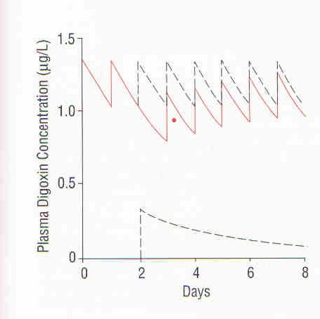
Checking Drug Concentrations

Slide 19
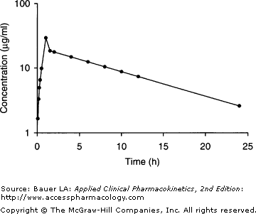
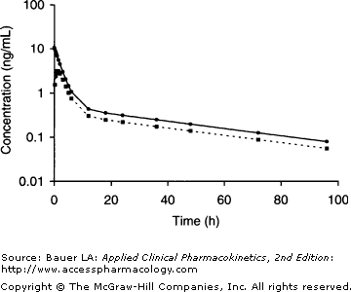
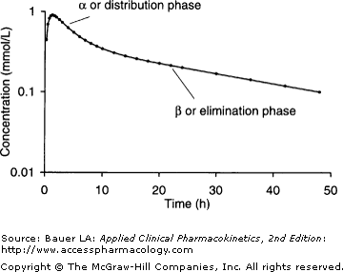
Checking Drug Concentrations
Allow Absorptive and Distributive Phases to End
log
Absorptive phase
Notes:
1st– Li, distibutive phase = 6-10 hours; 2nd– digoxin, distributive phase = 8-12 hours; 3rd vancomycin, distributive phase = 0.5-1 hours

Slide 20
Checking Drug Concentrations
Example #1
AB is receiving vancomycin 1250mg IV over 1 hour q12h for MRSA cellulitis. On day 4 of therapy, drug levels are checked.
Actual Wt= 85kg, CrCl = 120 mL/min
Vancomycin 1250mg q12h at 10am, 10pm
Infusions start at 1000 and 2200; end at 1100 and 2300
Drug levels checked day 4
0956 = 10 mg/L
1100 = 48 mg/L

Slide 21
Checking Drug Concentrations
Example #1
ke = ln (C1 /C2) / (Δt)
= ln (48/10) / (11h)
= 0.142 h⁻¹
t1/2 = 0.693 / ke
= 4.9 h

Slide 22
Checking Drug Concentrations
Example #1
Let’s say the peak concentration was drawn at 1200, and was 32 mg/L
ke = ln (C1 /C2) / (Δt)
= ln (33/10) / (10h)
= 0.119 h⁻¹
t1/2 = 0.693 / ke
= 5.8 h

Slide 23
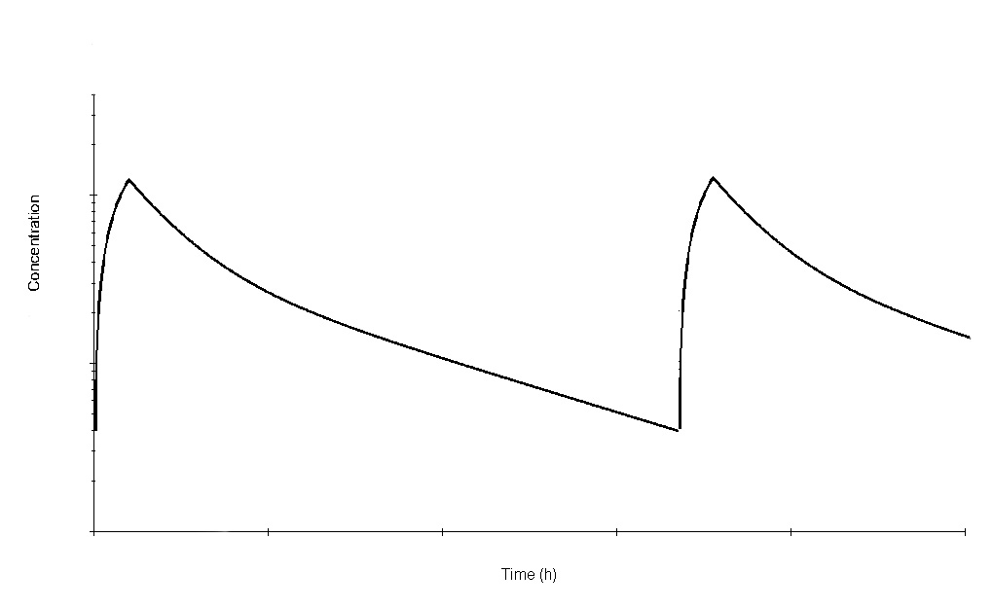
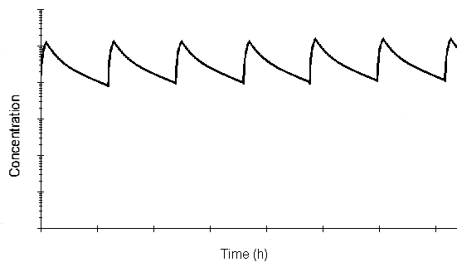


Keep in mind…

Slide 24
Checking Drug Concentrations
Early Peaks
ke (calc) > ke (actual)

Slide 25
Checking Drug Concentrations
Example #2
CD is receiving tobramycin 120mg IV over 30 min q8h for Pseudomonas bacteremia. On day 3 of therapy, drug levels are checked.
Dosing wt= 60kg, CrCl = 100 mL/min
Tobramycin 120mg q8h at 10am, 6pm, 2am
Infusions start at 1000, 1800, 0200; end at 1030, 1830, and 0230
Drug levels checked day 3/4
2200 = 4.1 mg/L
0155 = 1.2 mg/L

Slide 26
Checking Drug Concentrations
Example #2
ke = ln (C1 /C2) / (Δt)
= ln (4.1/1.2) / (4h)
= 0.307 h⁻¹
t1/2 = 0.693 / ke
= 2.2 h
C2= (C1) e^{-ket}
C1 = C2 / e^{-ket}
C1 = 4.1 mg/L / e^{-(0.307/h)(3h)}
= 10.3 mg/L

Slide 27
Checking Drug Concentrations
Late Peaks
ke (calc) = ke (actual)

Slide 28
Checking Drug Concentrations
Example #3
EF is receiving gentamicin 80mg IV over 30 min q8h for enterococcal endocarditis (with ampicillin 2gm q4h). On day 4 of therapy, drug levels are checked.
Dosing wt= 80kg, CrCl = 85 mL/min
Gentamicin 80mg q8h at 10am, 6pm, 2am
Infusions start at 1000, 1800, 0200; end at 1030, 1830, and 0230
Drug levels checked day 4
1900 = 4 mg/L
2300 = 1.4 mg/L

Slide 29
Checking Drug Concentrations
Example #3
ke = ln (C1 /C2) / (Δt)
= ln (4/1.4) / (4h)
= 0.263 h⁻¹
t1/2 = 0.693 / ke
= 2.6 h
C2= (C1) e^{-ket}
C2 = 1.4 mg/L x e^{-(0.263/h)(3h)}
= 0.63 mg/L

Slide 30
Checking Drug Concentrations
Early Troughs
ke (calc) = ke (actual)

Slide 31
Checking Drug Concentrations
Example #4 - Late Troughs
Gentamicin 120mg q8h at 10am, 6pm, 2am
Infusions start at 1000, 1800, 0200; end at 1030, 1830, and 0230
Drug levels checked day 4
1100 = 8 mg/L
1830 = 6 mg/L
ke (calc) < ke (actual)

Slide 32
Patient Case #1
The Order
NG is a 30-week-gestational infant in the IICU being treated with ampicillin and gentamicin 6 mg/kg over 1 hour q36h for suspected sepsis. A trough is ordered to be collected before the next dose, and a peak is ordered after the 1st dose Gentamicin is ordered to start at 3pm.
  Target peak in this situation = 9-12 mg/L
  Target trough in this situation = 0.8-1.5 mg/L

Slide 33
Patient Case #1
The Reality
Trough collected at 2:40pm and was <0.5 mg/L
Drug was given at 3:00pm as scheduled
Peak checked at 4:30pm and was 9.7 mg/L
The IICU team changed the order to 6 mg/kg q24h, based on a “low trough” even though the peak was therapeutic with only one dose AND the trough was collected before any drug was given. Pharmacists called to intervene.

Slide 34
Patient Case #2
The Order
SJ is a 59 YO with newly diagnosed metastatic lung CA with a SCr of 2.8 with an order for vancomycin 1gm q12h. The pharmacist working calls to question the order, and the MD states that he was increasing the dose since the trough was low.
Was on vancomycin 1gm q24h x4 days (10am dosing)
Random vancomycin concentration: <3.5 mg/L on day 4 at 2pm

Slide 35
Patient Case #2
The Reality
Pharmacist recommends checking another concentration
Level at 12am day 5 = 43 mg/L
Level at 6am day 6 = 36 mg/L
ke = 0.006h⁻¹
t1/2 = 115 h = 4.8 days
The order was held. ID was consulted and changed to amox/clav.

Slide 36
Clinical PK and TDM
1) Determine LD and MD using population parameters
2) Calculate expected drug levels
3) Draw drug levels at steady-state
4) Determine patient-specific ke, t1/2, Vd
5) Recalculate LD/MD using new parameters
6) Draw drug levels at steady-state if needed

